Slide 1
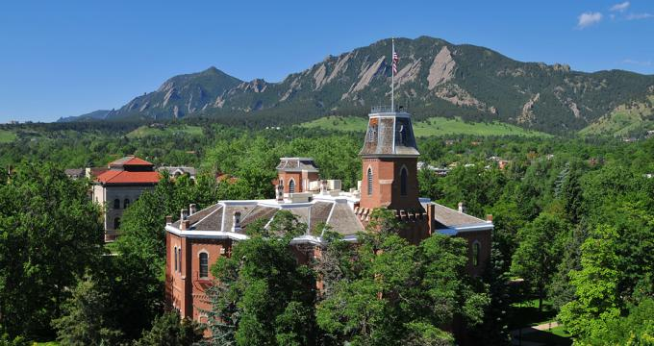



IEEE Wireless Power Transfer Conference 2015
Technology, Devices, Systems
May 13-15, 2015, Boulder, Colorado, U.S.A.
www.wptc2015.org Submission deadline: January 30, 2015
Conference General Chair
Zoya Popovic, Univ. of Colorado, Boulder
TPC Chair
Khurram Afridi, Univ. of Colorado, Boulder
Finance Chair
Dragan Maksimovic (Univ. of Colorado)
Publication Co-Chairs
Zeljko Pantic (Utah Stage University)
Mike Kelsenberg (Escape Dynamics)
Publicity Co-Chairs
Regan Zane (Utah State University, Logan)
Dmitriy Tseliakhovich (Escape Dynamics)
Industry Panel Co-Chairs
Kamil Grajski (Qualcomm), S. O’Driscoll (Google)
Poster Co-Chairs
Erich Grossman (NIST-Boulder)
Alenka Zajic (Georgia Tech)
Awards Committee Chair
Manos Tentzeris (Georgia Tech)
Local Arrangement/General Affairs
Jarka Hladisova (Univ. of Colorado)
Sean Korhummel (Univ. of Colorado)
Organizing Committee
George Ponchak (NASA), Jenshen Lin (Chair, MTT26), Regan Zane (USU-Logan), Manos Tenzeris (Georgia Tech), David Perrault (MIT), ), Seonjung Ahn (KAIST)
International Advisory Committee
Joungho Kim (KAIST),Naoki Shinohara (Kyoto University), Shigeo Kawasaki (JAXA), Luca Roselli (University of Perugia), Peter Russer (Technical Univ. of Munich), Alessandra Costanzo (Univ. of Bologna)
TPC Members (list not final)
Federico Alimenti (Univ. of Perugia), Ikuo Awai (Ryutech Corporation), Nuno Borges Carvalho (University of Aveiro), Debabani Choudhury (Intel Corporation), Ana Collado (CTTC), Damienne Bajon (ISAE, France), Giorgio Franceschetti (Univ. of Napoli),Ken-ichi Fujimaki (Sony), Apostolos Georgiadis (CTTC), Yahei Ishikawa (Murata Manufact. Co.,Ltd.), Toshio Ishizaki (Ryukoku Univ.) , Tatsuo Itoh (UCLA), Masaaki Kuzuhara (University of Fukui), Hai-Young Lee (Ajou University), Jenshan Lin (University of Florida), Stepan Lucyszyn (Imperial College London), Andrea Massa (University of Trento), Milos Mazanek (University of Prague), Junji Miyakoshi (Kyoto University), Mauro Mongiardo (Univ. of Perugia), Amir Mortazawi (University of Michigan), Kenjiro Nishikawa (Kagoshima University), Koichi Ogawa (Toyama University), Johannes Russer (Technical Univ. of Munich), Tomohiro Seki (NTT), Satoshi Shimokawa (Fujitsu Laboratory), Naoki Shinohara (Kyoto University), HirokiShoki (Toshiba co.), Ken Takei (Hitachi, Ltd.), Manos Tentzeris (Georgia Tech), Yoshiyuki Fujino (NICT), Young Jin Park (KERI), In-Kui Cho (ETRI), Kang Yoon Lee (Sungkyunkwan University), Masao Taki (Tokyo Metropolitan University)
Call for Papers
Driven by consumer awareness and demand for convenient charging, multiple technology approaches have been put forward and are active in the market. These approaches reflect the considerable growth in research and development of technologies for WPT. In response, a new technical committee of the IEEE MTT Society (TC-MTT-26) was formed in 2011 that focuses on wireless energy/power transmission, energy harvesting/conversion and related technologies. Following a successful meeting in Kyoto, Japan in 2012 (IMWS-IWPT2012), a new conference on wireless powering, rotating between Europe, Asia and North America, started in Perugia, Italy in 2013 and was followed by WPTC2014 in Jeju, Korea. The 2015 WPT conference will be held in Boulder, Colorado, USA, supported by TC-MTT-26, endorsed by TC-MTT-24 (RFID-Technologies) and hosted by the University of Colorado, Boulder. The meeting is intended to cover a broad range of areas related to devices, components, systems and applications of WPT across the electromagnetic spectrum.
Technical areas
Basic technologies for wireless power transfer systems
Near-field (inductive, resonant) power transfer
Microwave transmission and beaming
Coils, resonators, and antennas
Power management and power electronics for WPT
EMC/EMI, Shielding
Power transmitters and receivers for wireless power transfer systems
High-frequency power transmitters and devices
High-efficiency rectifying circuits and devices
Rectennas and rectenna arrays
Devices and techniques for energy harvesting and scavenging
Applications of wireless power transfer technologies
Mobile and personal devices
Home/Industrial-appliances
Electric vehicles
RF-ID and electronic tags
SPS and space/aeronautic applications
Medical and biological devices
Standardization, regulations and biological effects
Other device, system or application topics

Slide 2


IEEE Wireless Power Transfer Conference 2015
Technology, Devices, Systems
May 13-15, 2015, Boulder, Colorado, U.S.A.
Venue: University of Colorado, Boulder, U.S.A. Web site: www.wptc2015.org
Important dates:
Deadline for Submission of Preliminary Paper : February 6, 2015
Submission Guidelines: Authors are invited to submit no more than four-page paper in English. The paper should explain clearly the content and relevance of the proposed technical contribution. The paper will be peer-reviewed. Please use the On-Line-Submission system.
Notification of Acceptance : March 12, 2015
Deadline for Submission of Final Paper : April 5, 2015
Conference Date : May 13-15, 2015
Accepted papers will appear in the WPTC-2015 conference proceedings and will be included in IEEE Xplore.
A WPTC-2015 Prize will be given to the Best Conference Paper , selected by the WPTC-2014 Awards Committee
Registration Fee:
PRESENTING AUTHORS MUST PRE-REGISTER BY April 30, 2015
(Only pre-registered paper will be published in the final technical program and IEEE Xplore)
Conference dinner reception, lunches and coffee breaks:
Conference registration includes coffee breaks, lunches, a welcome reception and a dinner on Thursday night.
Conference hotel: Millennium Harvest House, Boulder 1345 28th St, Boulder, CO 80302
www.millenniumhotels.com/usa/millenniumboulder/‎
Contacts: Organizing committee wptc2015@colorado.edu
 | IEEE Members | Non-IEEE Members | Students and Life Members
Early registration (by March 31) | $ 350 | $ 400 | $ 150
Late (by April 30) and on-site registration | $ 450 | $ 500 | $ 250

